Slide 1


Golem Network Provider Node
(Mostly) Automated Deployment Presentation
Adam Mayfield
2 April, 2021
Github - https://github.com/r34x/Automatic-Golem
Reddit - /u/r4x
Discord - r4x#2916
Email – amayfield1979@gmail.com

Slide 2
Purpose
The reason behind this automated provider install is to help standardize installations across the network to known-good states. This will aid in troubleshooting nodes and resolving bugs.

Slide 3
Objective
The objective is to build a 90-95% automated build that will aid new providers in setting up their nodes without needing a lot of Linux or blockchain experience. This will help providers become more effective with less troubleshooting.

Slide 4
Prerequisites
The following prerequisites must be met in order for this to work:
Debian-based Linux install (Ubuntu, Mint, etc…)
KVM Must be installed prior to running the Provider installer.
You can test this by running sudo kvm-ok to verify
BASIC Linux experience, but this whole project is geared towards inexperienced users with limited experience.

Slide 5
Instructions
Download GolemDeploy.sh and golemsp.service from https://github.com/r34x/Automatic-Golem
Copy the files to the Linux machine you wish to deploy on. Recommend putting them in the /home/<user>/Documents folder.
Copy or move the golemsp.service file to /etc/systemd/system.
Edit the golemsp.service file and change the fields that contain <your username> to whatever the username of the system is. Remove the brackets when doing so.
Navigate to /home/<user>/Documents
Launch the installer by running ./GolemDeploy.sh
Follow the on-screen instructions
Enjoy your newly configured provider!

Slide 6
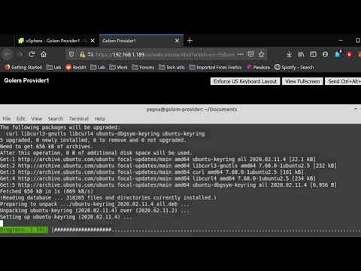
Demo Walkthrough.
This walkthrough assumes you already have KVM installed as part of the prerequisites. It does not show copying the golemsp.service file to /etc/systemd/system or modifying the file.

Slide 7
Monitoring Your Provider
I’ve added some nice features for monitoring your system and Golem Provider.
A Netdata install is included that allows you to monitor every aspect of your machine. More info about Netdata is available on their site
https://www.netdata.cloud/
I’ve also included a continuous monitoring command to monitor the provider itself by setting up a watch command to refresh the golemsp status command every 2 seconds. My testing has shown that this also helps keep the provider alive by sending input to the system so no timeouts happen for inactivity.

Slide 8
Conclusion
This project was a lot of fun to work on and I hope it helps you become a better provider and allows you to get up to speed quickly. If you have any questions, please reach out. My contact info is on Page 1.
Thank you!

